Slide 1
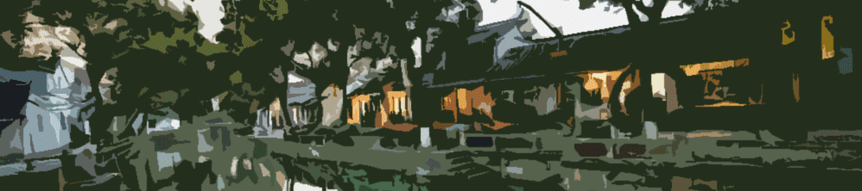
History of Urban Development of Suzhou
Student: Sarry

Slide 2
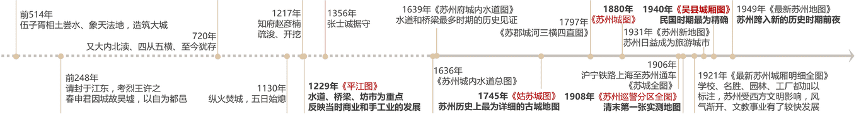
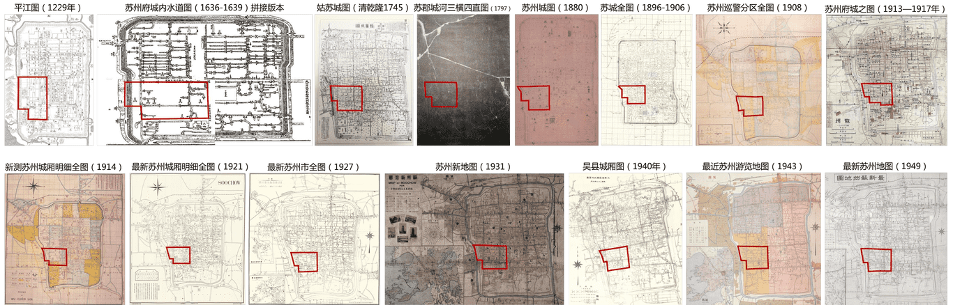
Notes:
Suzhou was built in 514 BC 公元前
And the maps we have now are from 1229 AD. New maps were made every once in a while. These maps show the development of Suzhou City.

Slide 3
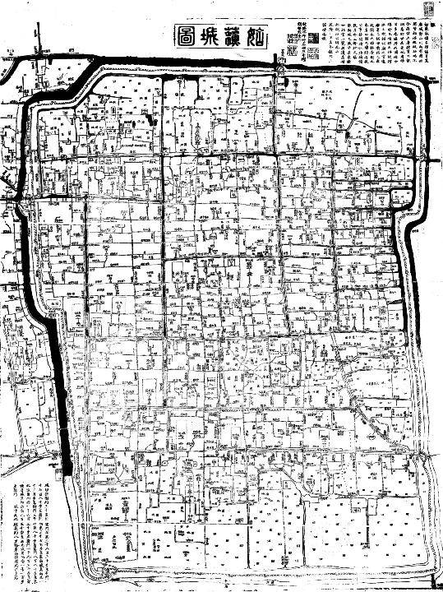
1745
Notes:
Here is the most detailed map of old Suzhou City. There are lot of rivers, load, paths and gardens. On the outskirts of the city are fields.

Slide 4
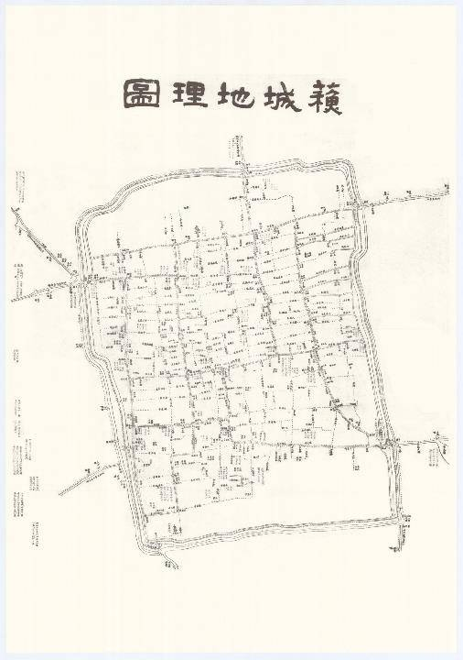
1864-1873
Notes:
In this map, you can see the rivers and streets.

Slide 5
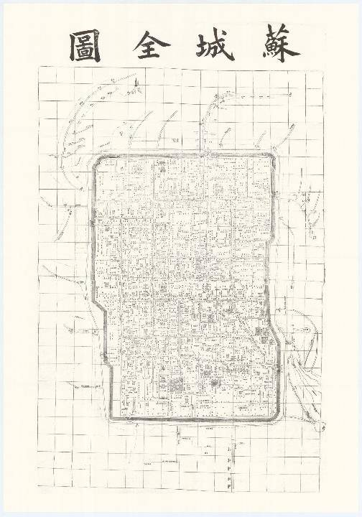
1896-1906

Slide 6
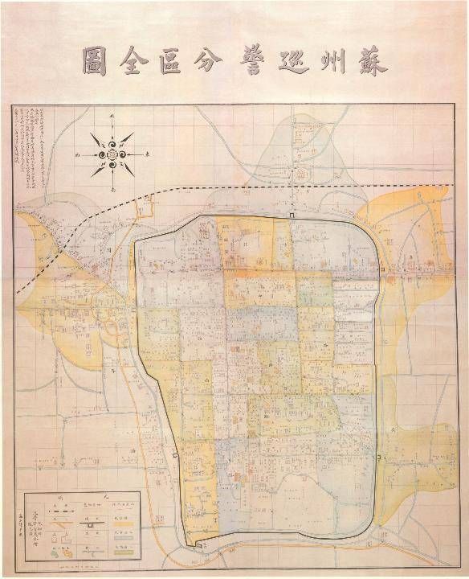
1908
Notes:
You can see the railway on this map. Western legends were used.

Slide 7
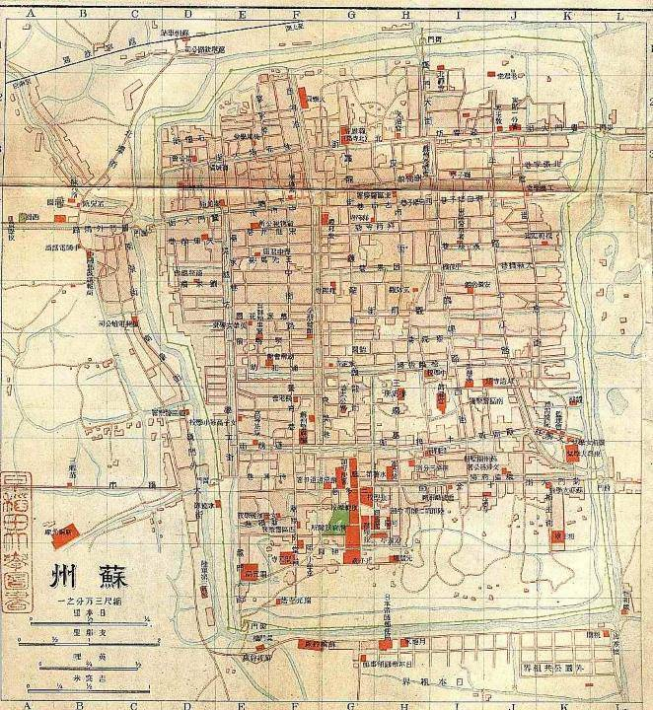
1913-1917

Slide 8
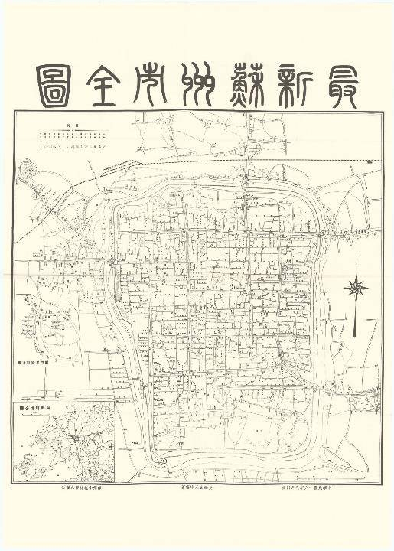
1927

Slide 9
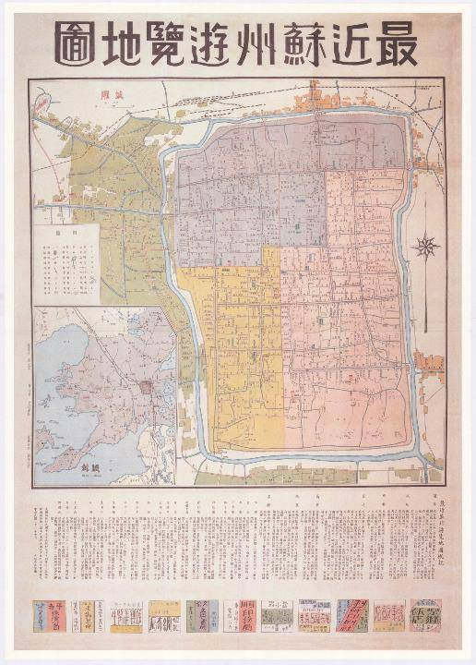
1943

Slide 10
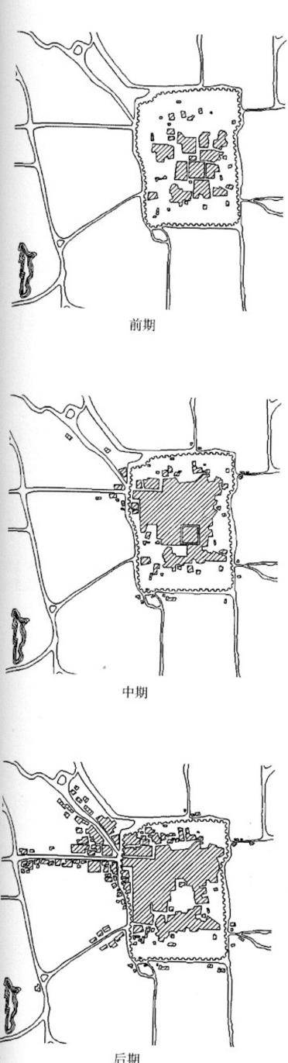


Ancient Suzhou city form evolution diagram

Slide 11
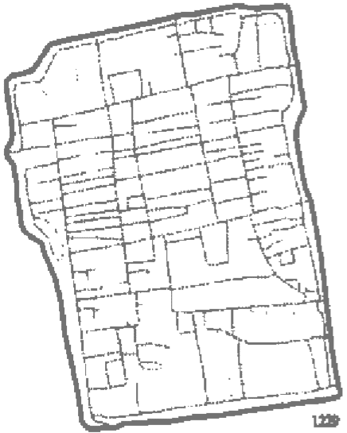
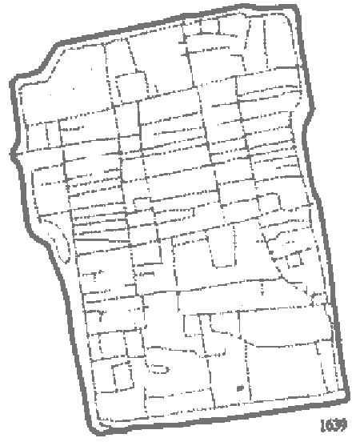
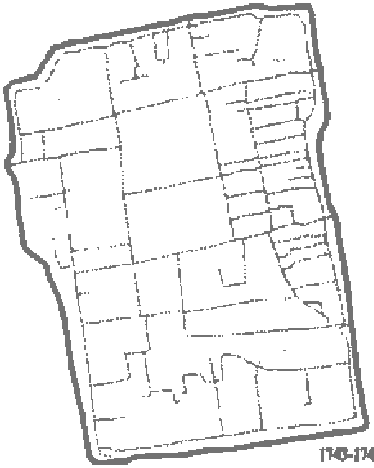
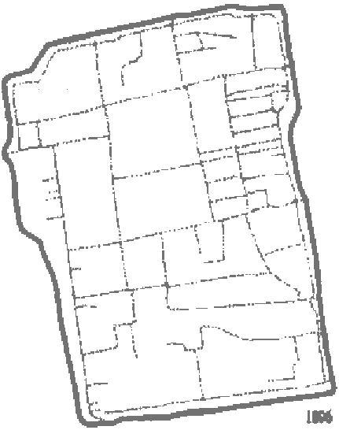
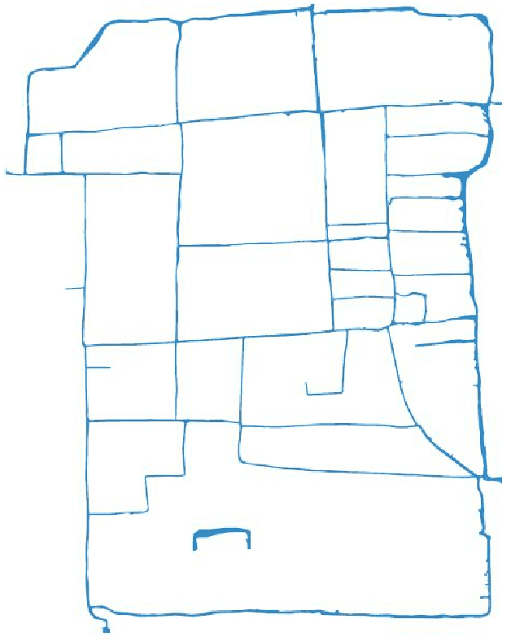
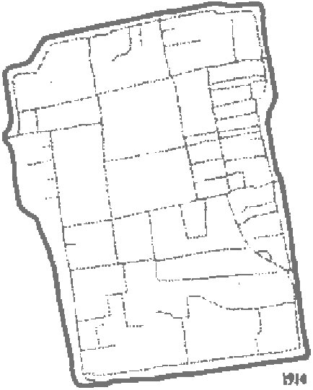
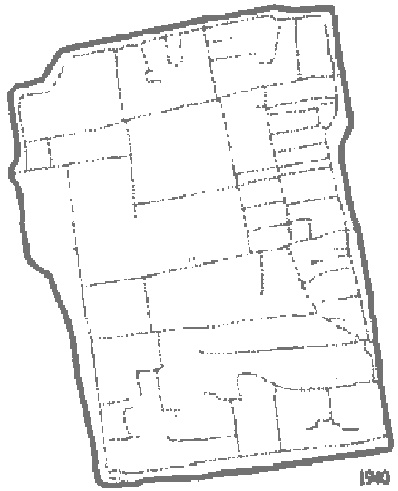
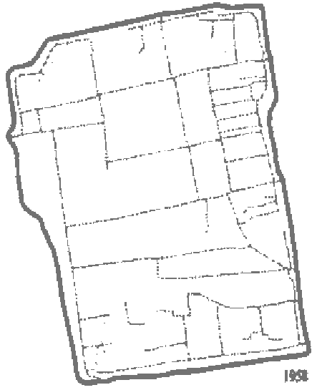
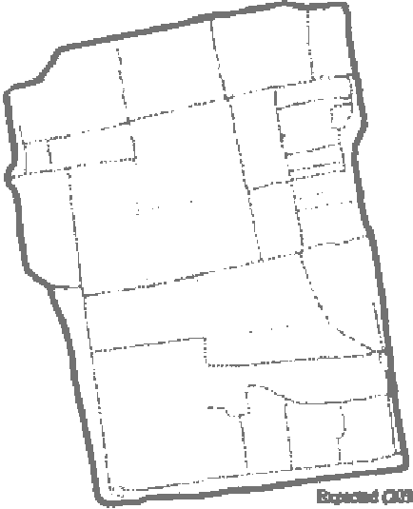
River system
Suzhou water system has experienced four stages: main network, densification of river network, disappearance of tributaries and filling of dry network, which is closely related to the change of neighborhood functions
1229, Song dynasty
Three horizontal and four straight channels appeared
1639, Ming dynasty
The period of maximum tributaries
1745, Qing dynasty
1906, Qing dynasty
The tributary system was reduced
1950
Early days of new China
1914
Main river system (1797):
Three horizontal, four straight
1940
The northern section of the second straight river was filled up and disappeared
2018
the Republic of China era
The second straight river disappeared completely

Slide 12
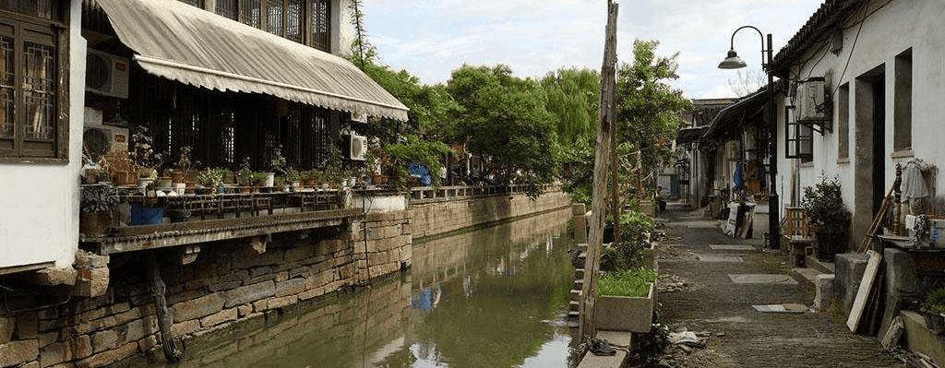
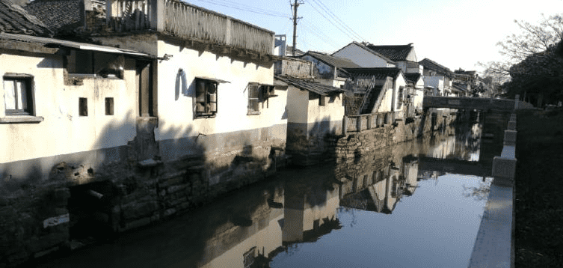
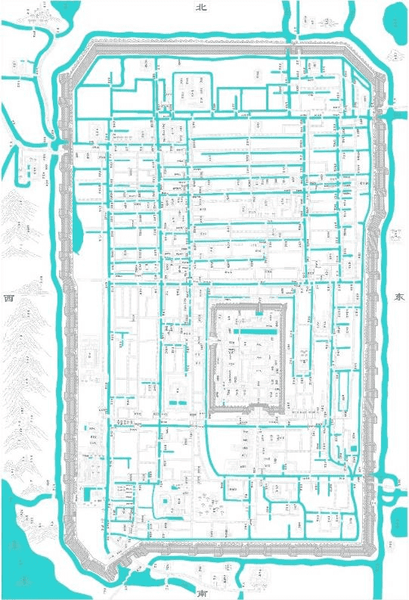
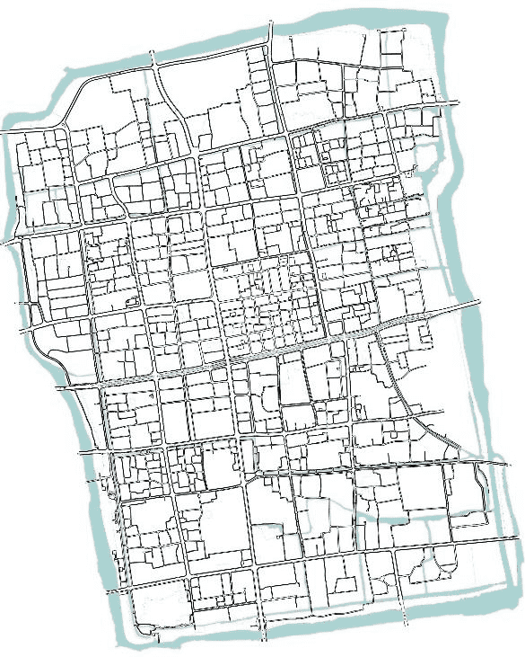
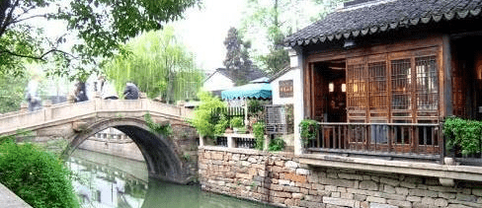
River system
The ancient river course of Suzhou is an important part of the Grand Canal, a world cultural heritage. The existing traditional revetment in the ancient city is more, but the original ancient revetment is rare.

Slide 13
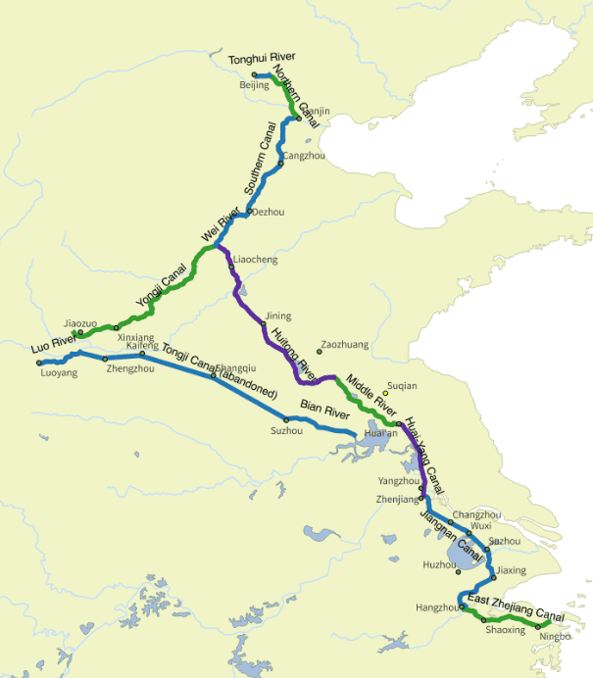
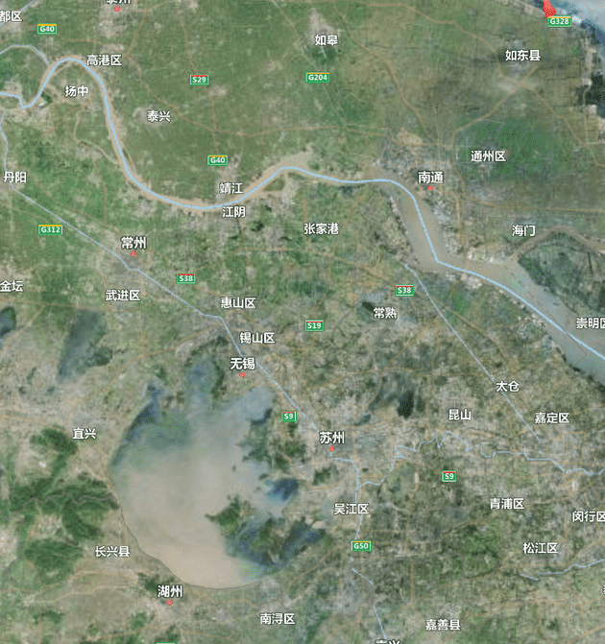
River system
Grand Canal

Slide 14
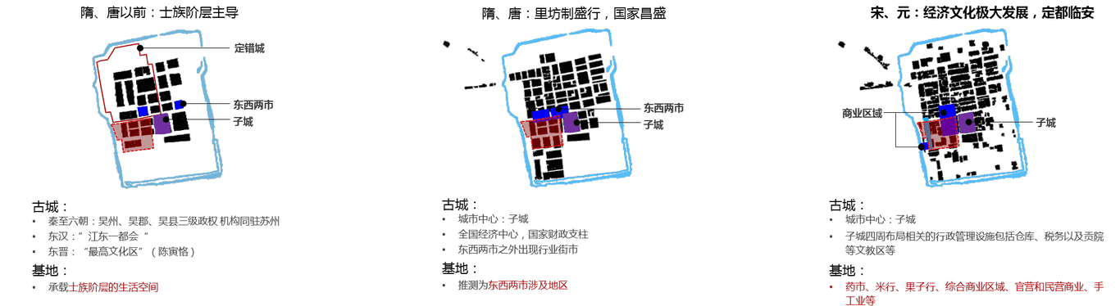
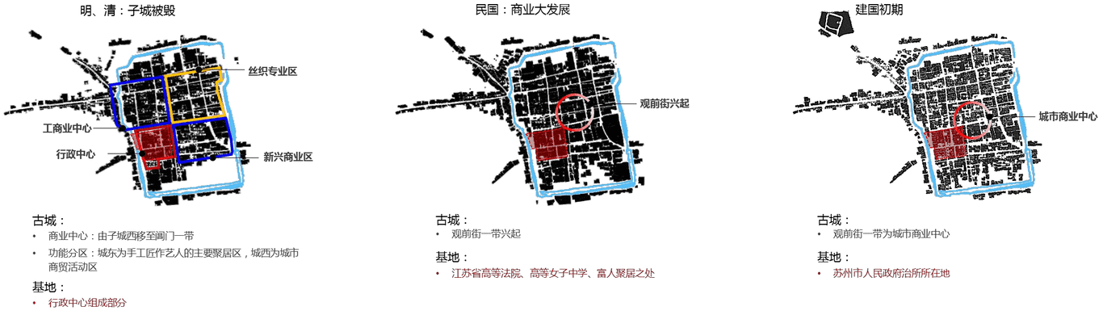
Commerce
Before the sui and tang dynasties
Sui and Tang dynasties
Song and Yuan dynasties
Royal residence
A small city within a larger one
government office
Market
Market
A small city within a larger one
government office
Market
A small city within a larger one
government office
the Republic of China
Ming and Qing dynasties (no Small city)
Early days of new China
urban commercial center
industry and commerce center
The rise of Guanqian Street
Silk weaving area
New business district

Slide 15
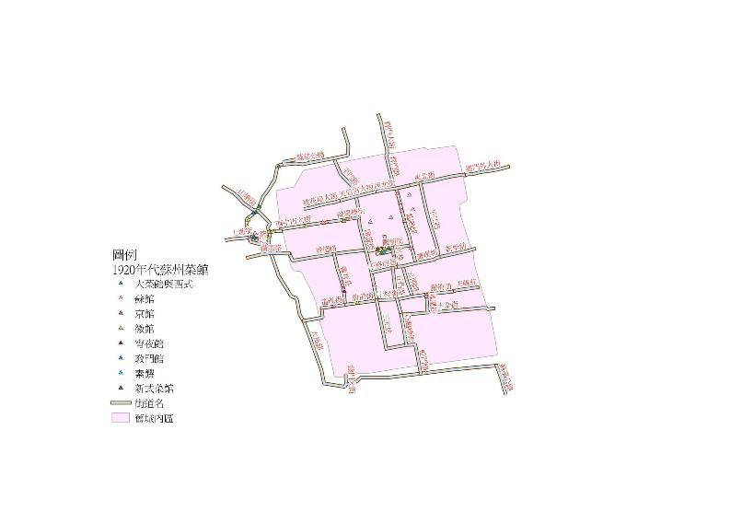
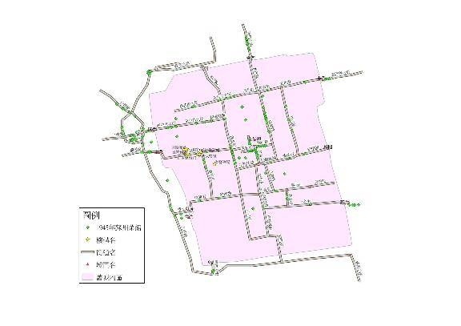
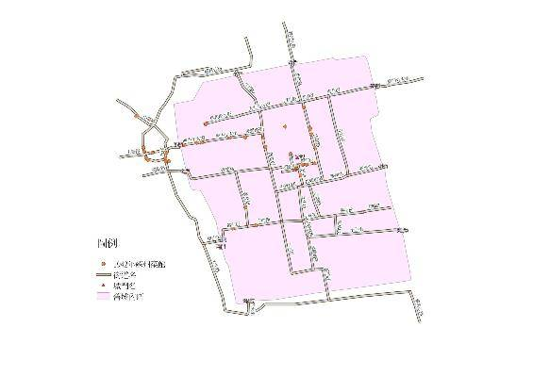
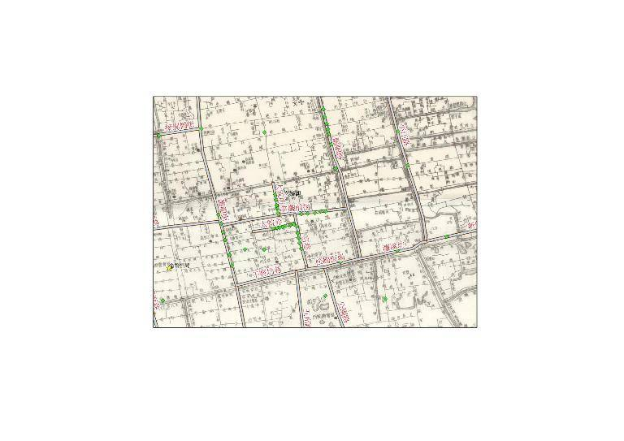
Commerce
Take the restaurant as an example
1920s to mid-1930s
1945
1942

Slide 16
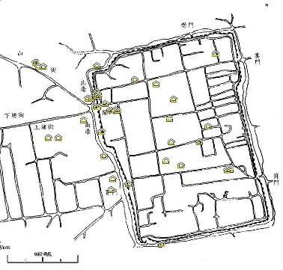
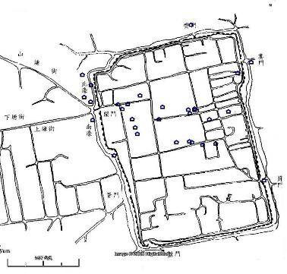
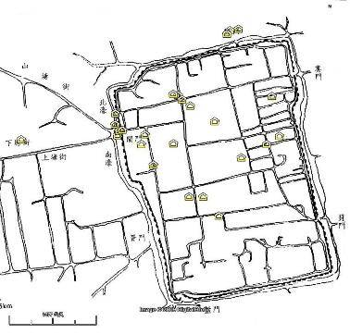
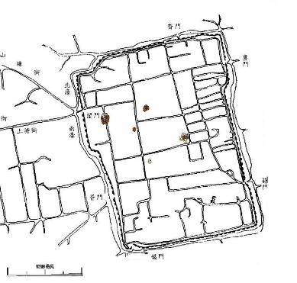
Commerce
Industry guild halls and banks
Before Qing Daoguang (1821-1850)
1920s
After Qing Xianfeng (1850-1861)

Slide 17



Residential shape
Siheyuan model
Triheyuan + quadrangle mode
Double courtyard model

Slide 18
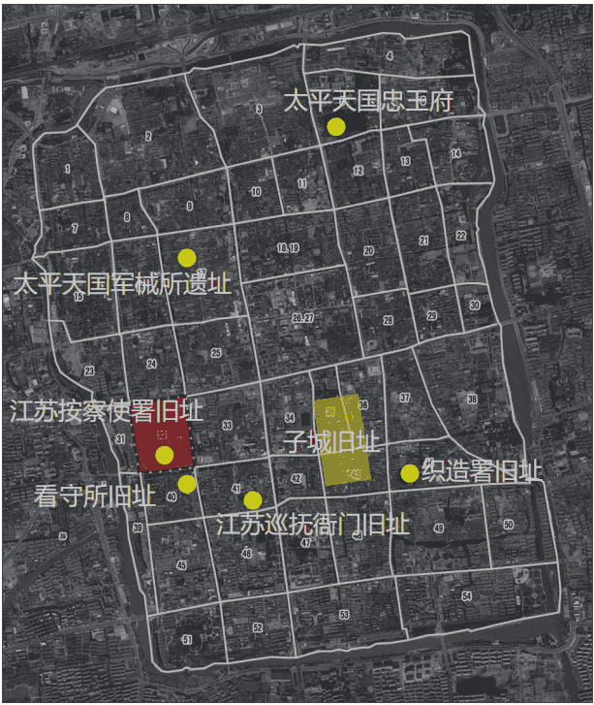
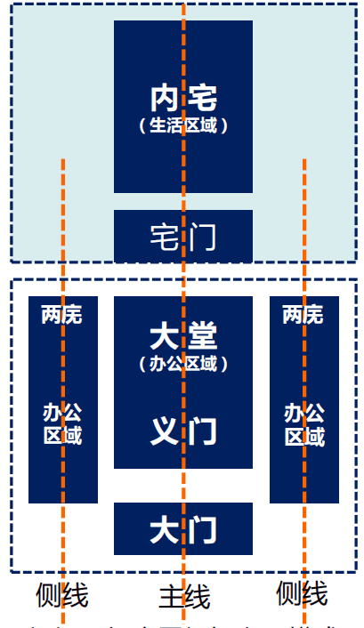
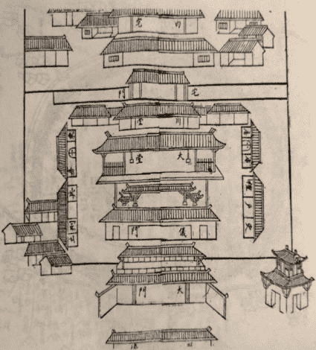
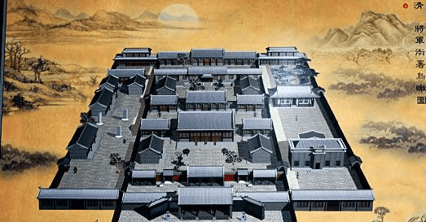
government office
According to the general government office yamen layout pattern, the original layout of speculation
Office yamen space layout model diagram

Slide 19
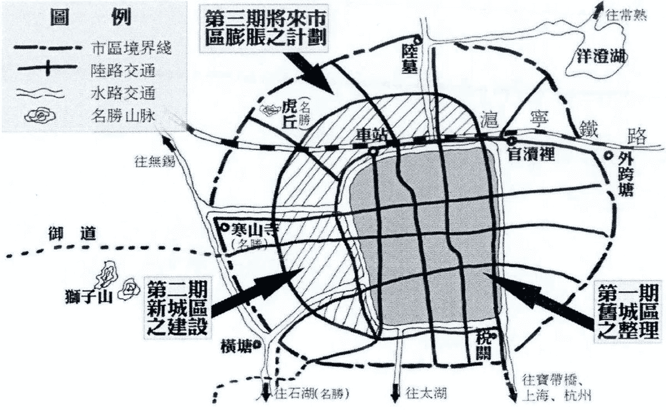
The government's urban planning for Suzhou
Urban development direction: the external transportation of Suzhou is mostly by water except Shanghai-Nanjing railway, which is concentrated in the western half of the city, and most of the scenic spots are also distributed in the southwest...The future development trend of Suzhou will be concentrated in the western area outside the city;
Division planning by stages: the first phase is the "consolidation of the old city", that is, the improvement planning of the old city.The second phase is the "construction of the new city" in the west and north of the ancient city, namely the development planning of the new city.The third phase of the "future urban expansion plan" centered on the old and new urban areas, that is, urban expansion planning.
1927

Slide 20
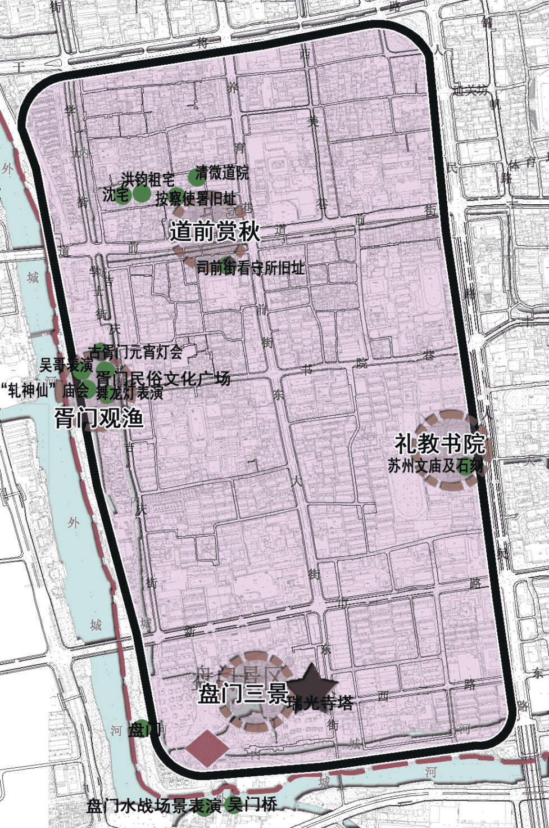
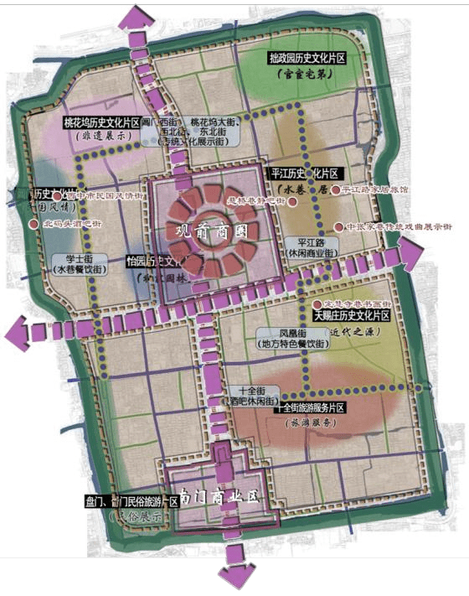
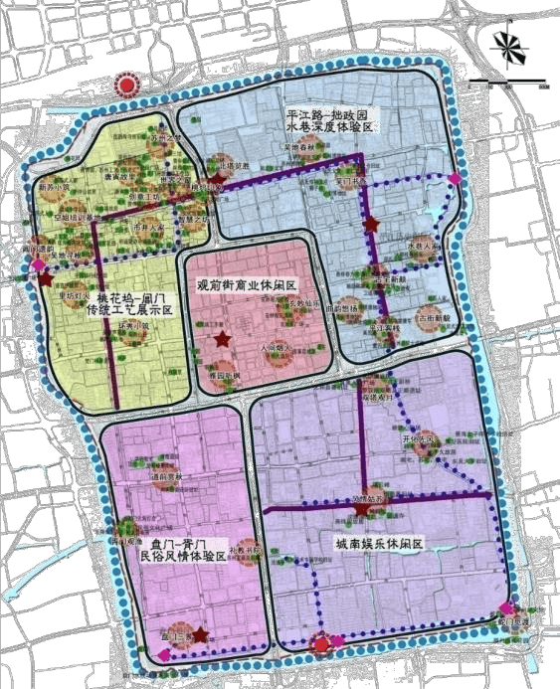
The government's urban planning for Suzhou
2012

Slide 21
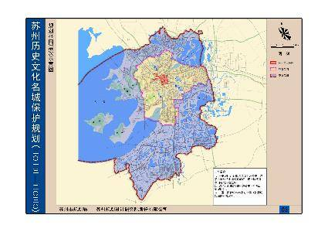
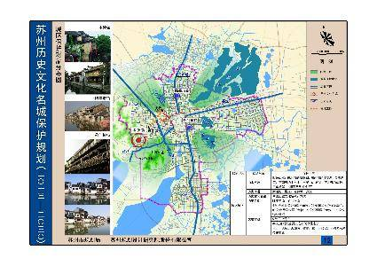
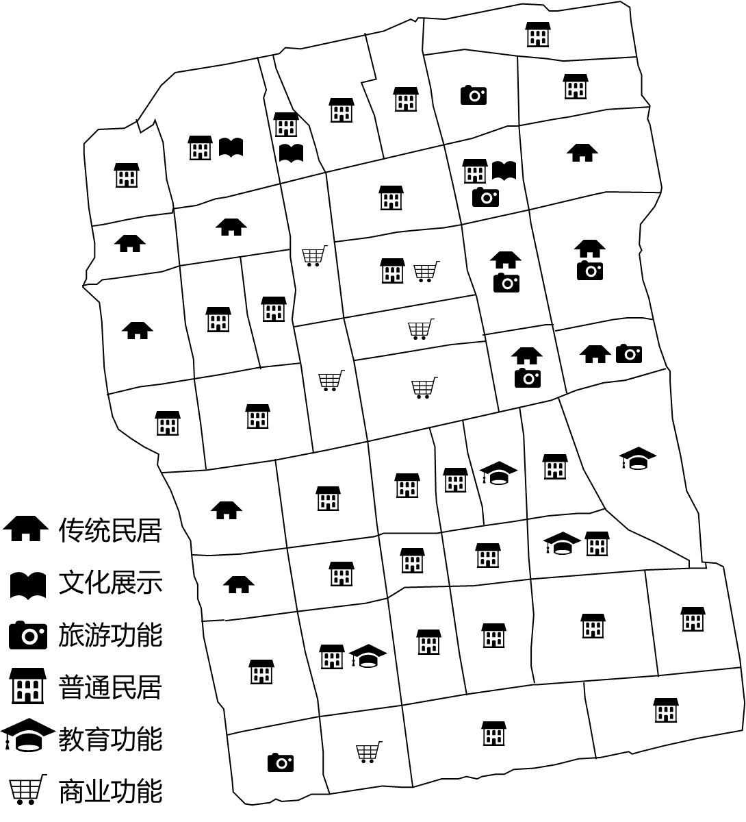
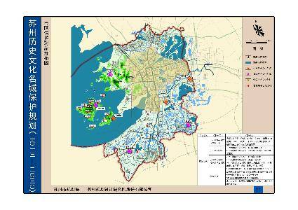
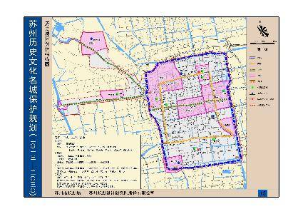
The government's urban planning for Suzhou
2013-2030

Slide 22





The government's urban planning for Suzhou
Community tourism
2016—2025

Slide 23

Yona Friedman

Slide 24

Sky City （What if people live in sky?)
Basic information
Citizen
Where to live?
Flow rules

Slide 25

1. Basic information

Slide 26


2. Users are at the basis of the evolution of urban patterns
10 different citizens archetypes (American Time Use Survey, 2008)
User ID
Start time of activity
End time of activity
Duration of activity
K-means clustering
Student
Gamer
Part-time
Volunteer
Retired
Regular Worker
Unemployed
Homemaker
Workaholic
Stay-at-home parent

Slide 27




3. Where to live?
Pod is the smallest building unit in Sky City. These functional spaces cater to the basic activities of the citizens.
The location, design, and aggregation of pods and objects will controlled by some parameters, like activity, sunlight, privacy, noise.
Voxel

Slide 28



3. Where to live?
Three ways to control aggregations:
Connection Rules
Cluster Rules
Conditional Rules

Slide 29







3. Where to live?

Slide 30




4. Flow rule
Main categories of flows:
Object flows
User flows
Goods flows
1. Flow behavior
2. Intensity behavior
3. Distribution behavior
4. Separation behavior
5. Bunding behavior
Object Flows
User Flows
Goods Flows

Slide 31

Cloud city

Slide 32

Cloud City is floating above the surface of the planet Bespin, the city was specifically designed to harvest tibanna gas which is used in all kinds of technology in the Star Wars galaxy. The station was situated 59,000 kilometers above Bespin's core, while its disk was approximately 16.2 kilometers in diameter.

Slide 33

36,000 repulsorlift engines and tractor beam generators kept the giant city floating above the planet. It contained 392 levels, along with platforms and rooms for residents and visitors.

Slide 34





Slide 35
The first hypothesis:
The buoyancy generated by heating the air to make the city float in the air.
Fuller suggested that the mass of a mile-wide geodesic sphere would be negligible compared to the mass of the air trapped within it. He suggested that if the air inside such a sphere were heated even by one degree higher than the ambient temperature of its surroundings, the sphere could become airborne.
heating the air →
generate buoyancy →
make the city float

Slide 36

The second hypothesis:
To have the city exist in a very low orbit around the planet

Slide 37
If we assume the entire city is made out of steel
→ the necessary force would be 3.82 × 1025 pounds
= ten thousand times the force between Earth and the Sun.

Slide 38
To maintain such an orbit, the city would have to move horizontally quickly enough that the planet curved away from it just as swiftly as the city moves around it.

Slide 39
NASA put out a report in April 2015
Bryan Palaszewski describes methods and vehicles that can be used to harvest gas from the outer planets of the solar system. He details the use of unmanned aerial vehicles that would harvest helium gas from the atmospheres of Neptune and Uranus before returning to a mother ship in orbit around the planets to deliver their payload.

Slide 40
References
Andy.Z. In Empire Strikes Back, how does Lando's Cloud City work?
Retrieved from: https://www.quora.com/In-Empire-Strikes-Back-how-does-Landos-Cloud-City-work.
Cloud City. Retrieved from: https://starwars.fandom.com/wiki/Cloud_City
Star Wars: Absolutely Everything You Need to Know. Retrieved from: https://starwars.fandom.com/wiki/Cloud_City
M89. (2019, February 9). Sky City| The Why Factory. Retrieved from: https://www.m89.no/work-twf_skycity.html
Star Wars Battlefront.Retrieved from: https://starwars.fandom.com/wiki/Cloud_City
Star Wars: Uprising.Retrieved from: https://starwars.fandom.com/wiki/Cloud_City
The Physics of Star Wars: The Science Behind a Galaxy Far, Far Away by Patrick Johnson. Copyright © 2017 Adams Media, a division of Simon and Schuster. Used by permission of the publisher. All rights reserved. Retrieved from: https://www.popsci.com/star-wars-physics-cloud-city/
The Why Factory. (2019, February 25). What if we could fly? Retrieved from: https://thewhyfactory.com/news/what-if-we-could-fly-sky-city-presentation/
The Why Factory. (2018). Sky city, The Hitchhiker’s Guide to Sky Angeles Retrieved from: https://issuu.com/twf-skycity/docs/why_factory_final_book-compressed

